Slide 1



Sixth Semester
Engineering Economics
HSS- 4002
Lecture 01
Lidwin Kenneth Michael
Faculty, Dept. of Humanities and Management,
Manipal Institute of Technology - Manipal

Slide 2

Fundamental Economic Concepts
Introduction to Economics
Decision Making process
Micro Economics
Macro Economics

Slide 3
Introduction
What Is Economics ?
The study of how limited resources is used to satisfy unlimited human wants.
What is Engineering Economics ?
The science that deals with techniques of qualitative analysis useful for selecting a preferable alternative from several technically viable ones.

Slide 4
Importance of Engineering Economics to Engineers:
It Helps in Decision making.
ex:
Engineers mainly deal with the issues of production process, design and the quality.
Engineers must be concerned with the economic aspects of designs and projects they recommend and perform.
To make engineers cost conscious in all their operations.

Slide 5
Decision Making:
Decision making process consists of choosing from among alternative courses of action.
The Decision-Making Process
Understand the Problem
Identify the decision criterion
Allocating Weights to the Criteria
Developing Alternatives
Analyzing alternatives
Select the “best” alternative
Implementing
Monitoring

Slide 6
Step 1: Identifying the Problem
Problem
A discrepancy between an existing and desired state of affairs.
Characteristics of Problems
A problem becomes a problem when a manager becomes aware of it.
There is pressure to solve the problem.
The manager must have the authority, information, or resources needed to solve the problem.
Notes:
Bad roads

Slide 7
Step 2: Identifying Decision Criteria
Decision criteria are factors that are important (relevant) to resolving the problem.
Costs that will be incurred (investments required)
Risks likely to be encountered (chance of failure)
Step 3: Allocating Weights to the Criteria
Decision criteria are not of equal importance:
Assigning a weight to each item places the items in the correct priority order of their importance in the decision making process.

Slide 8
Step 4: Developing Alternatives
Identifying viable alternatives
Alternatives are listed (without evaluation) that can resolve the problem.
If good alternatives are missed, the resulting decision is poor.
Step 5: Analyzing Alternatives
Appraising each alternative’s strengths and weaknesses
An alternative’s appraisal is based on its ability to resolve the identified issue.

Slide 9
Step 6: Selecting an Alternative
Choosing the best alternative
The alternative which best suits the requirement is selected.
Step 7: Implementing the Alternative
Putting the chosen alternative into action.
Conveying the decision to and gaining commitment from those who will carry out the decision.

Slide 10
Step 8:Evaluating the Decision’s Effectiveness
The soundness of the decision is judged by its outcomes.
How effectively was the problem resolved by outcomes resulting from the chosen alternatives?
If the problem was not resolved, what went wrong?

Slide 11
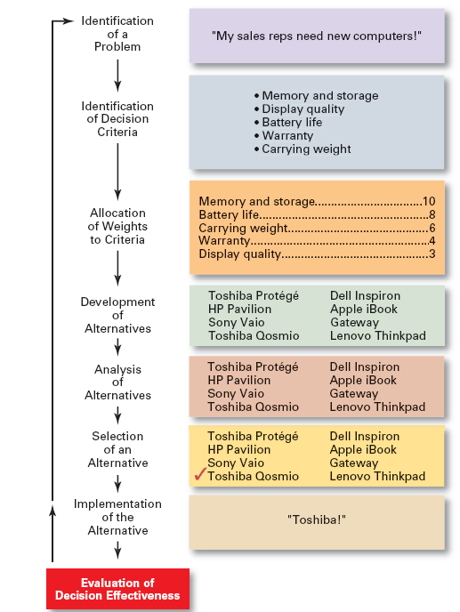
The Decision-Making Process

Slide 12
Micro and Macro Economics
Micro Economics:
It deals with problems of individual firm, industry, consumer.
Helps in studying what is going on within the firm.
Helps in deciding how best to use the available resources between various activities of the firm.
Micro economic concepts are simple & easy to understand.

Slide 13
Micro and Macro Economics
Macro Economics :
Macro economics examines the aggregate behaviour of the economy.
This studies the behaviour of economy as a whole not just on specific industries.
Measuring inflation or unemployment comes under macroeconomics.
These concepts are not simple & direct.

